Slide 1
Week-7: Gladiators
Team Members: Shivani Asokumar, Akash Narang, Mit Jain, Juhi Malkani
Team Lead: Akash Narang

Slide 2

Project: E-commerce Website for Footwear
Shopping Cart/Wishlist
Men’s/Women’s Section
Best Sellers in Footwear
Checkout and Payment
Order Summary
Seller Page
User Authentication

Slide 3


Technologies Used

Slide 4
Team Progress Update
Static Seller page (completed)
Integration of APIs into seller page (In progress)
Static Product Listing Page (completed)
Frontend
Backend APIs have been setup
Product Listing API (completed)
Seller Page APIs (completed)
Individual Product Page, Wishlist, Shopping Cart APIs (In progress)
Backend

Slide 5
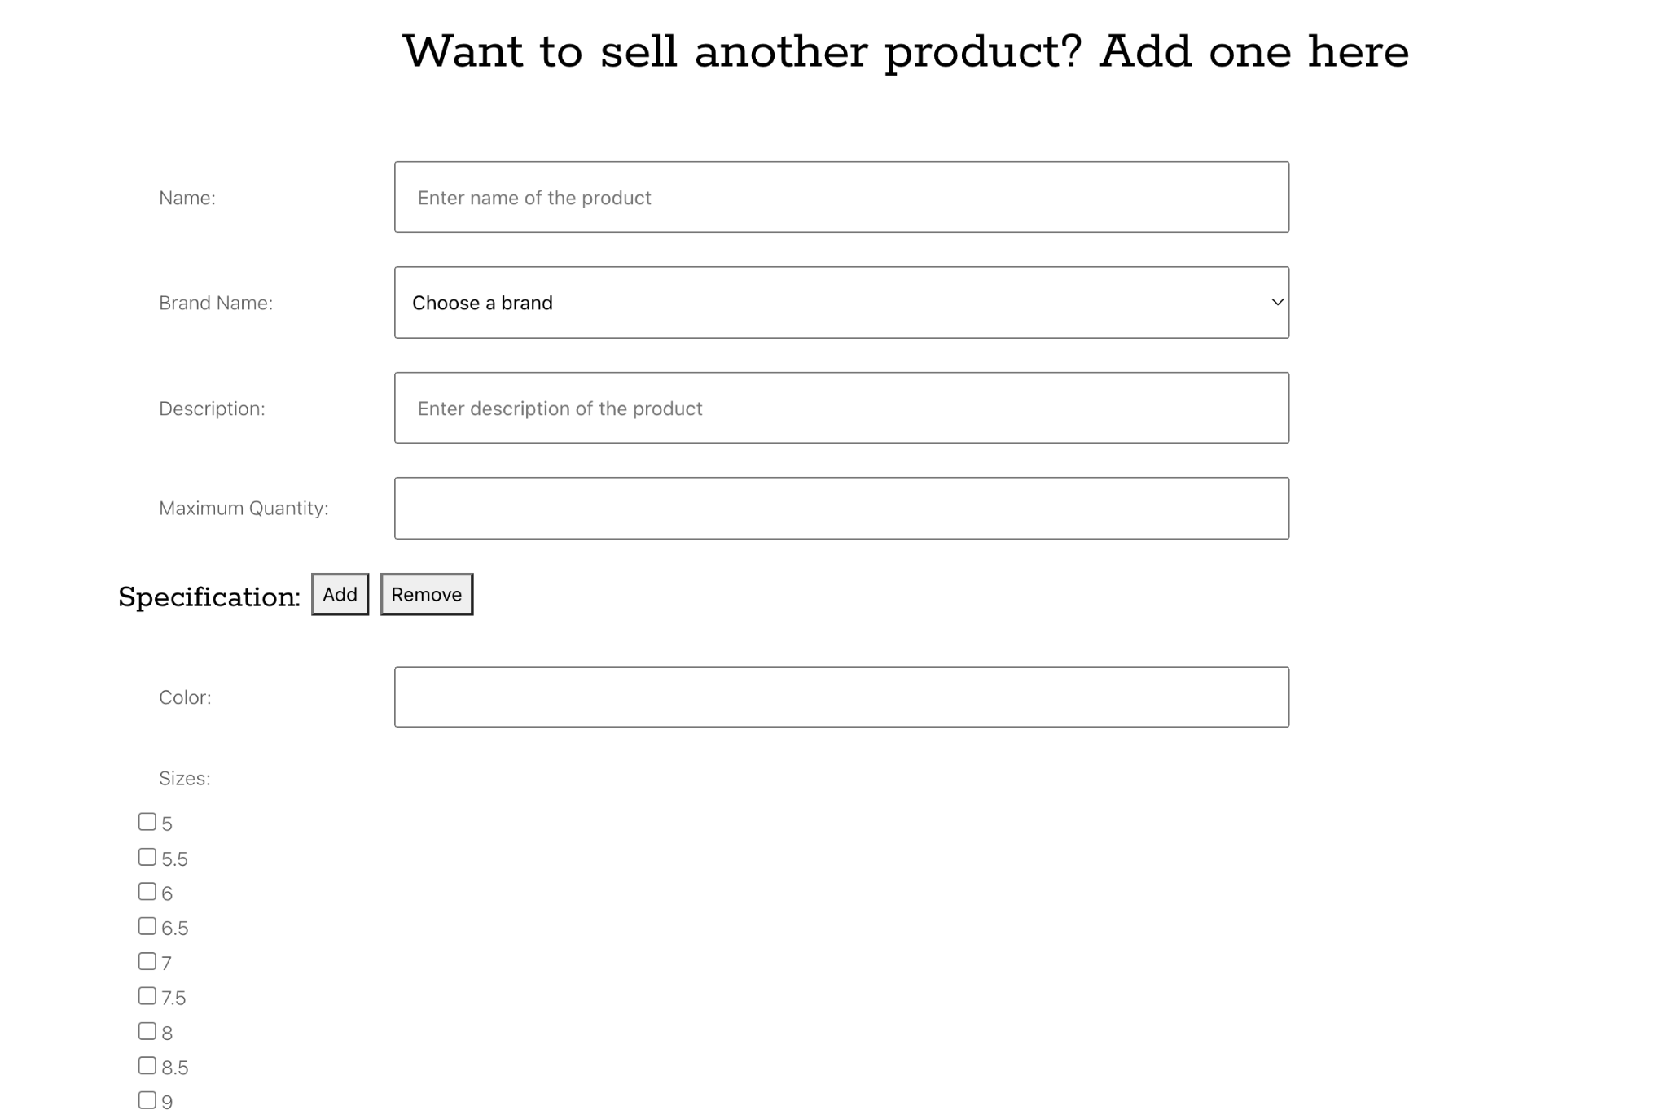
Static Seller Page (Completed)

Slide 6
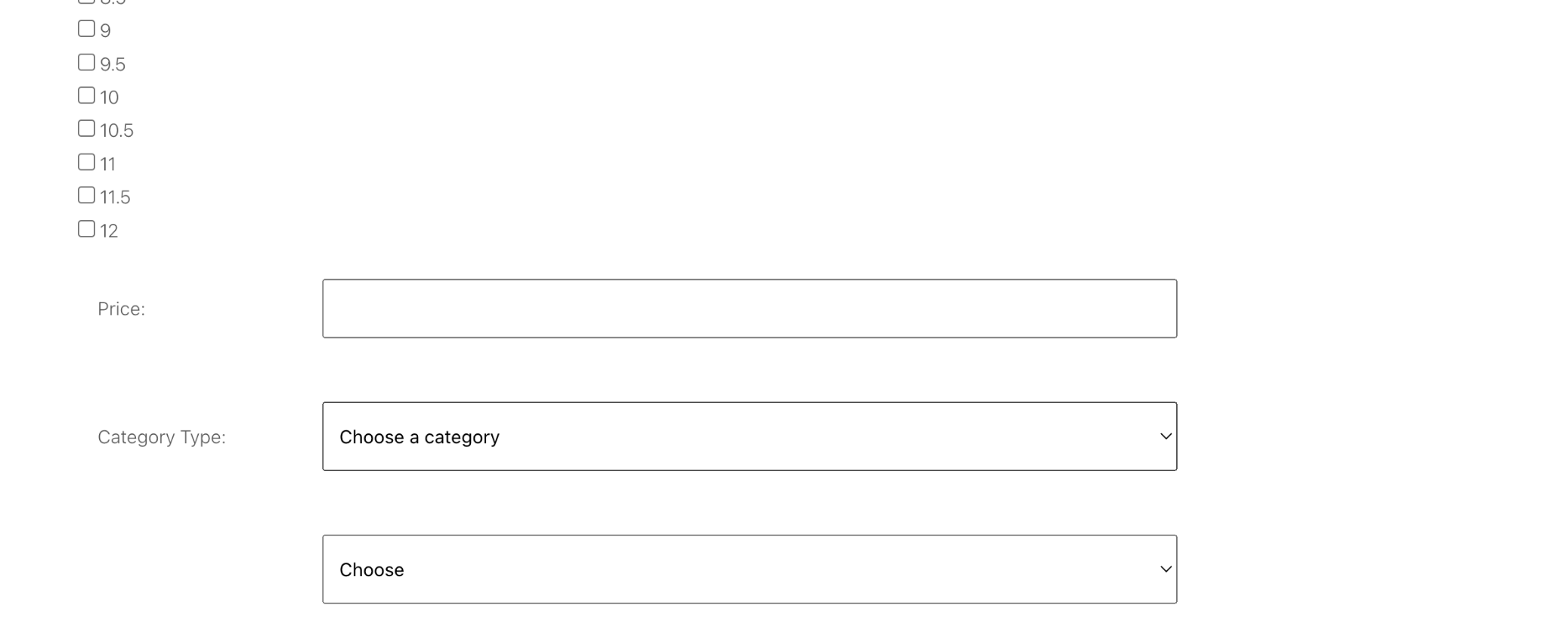
Static Seller Page (Completed)

Slide 7
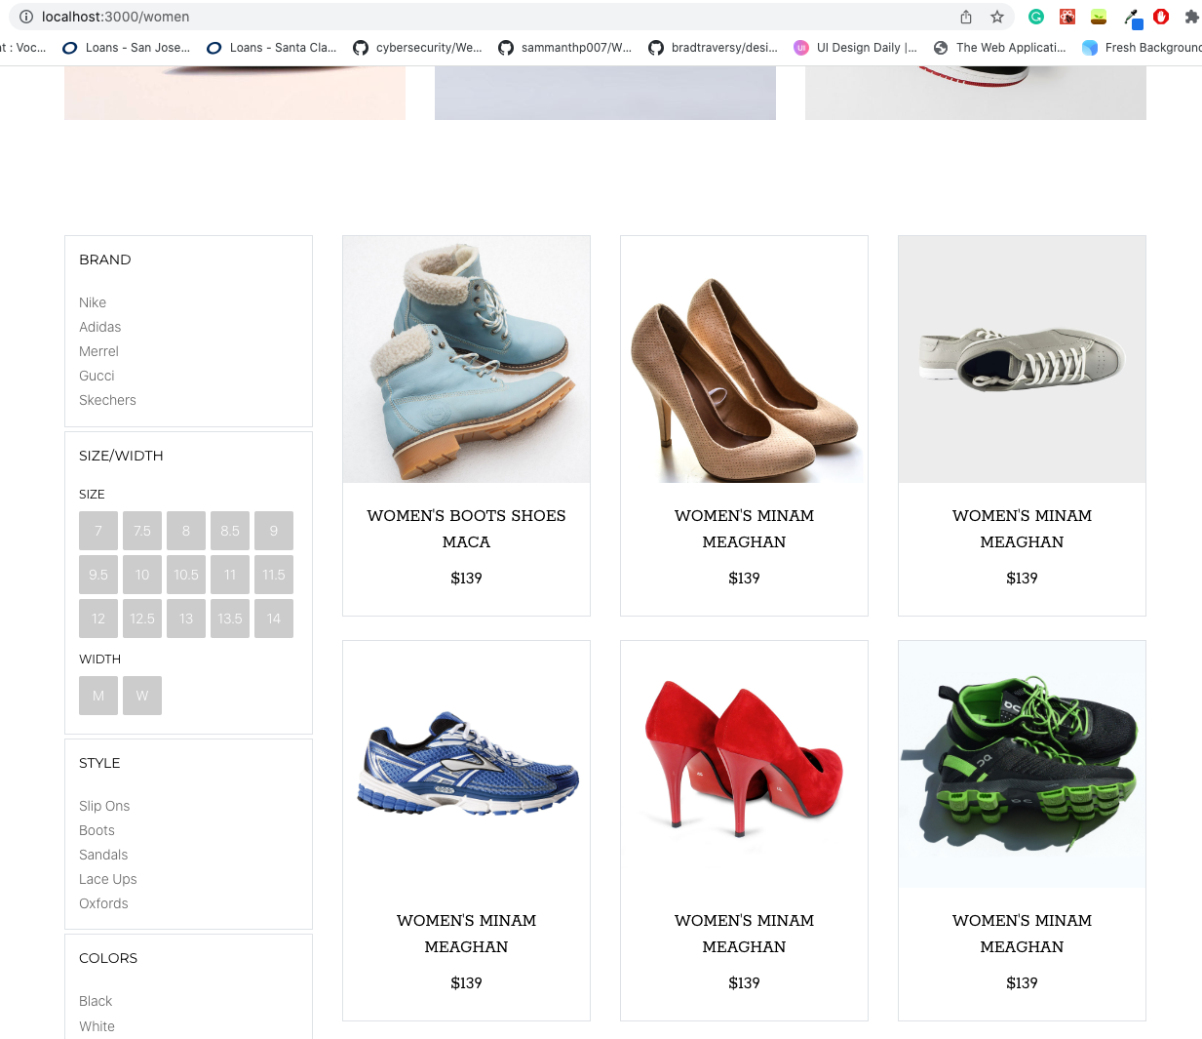
Product Listing

Slide 8
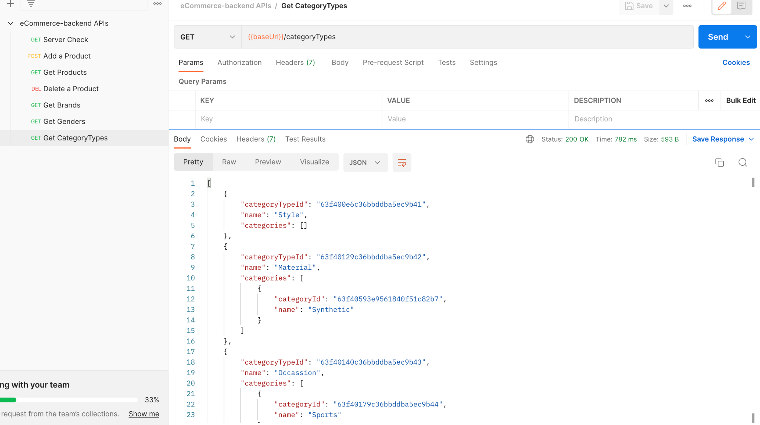

Slide 9
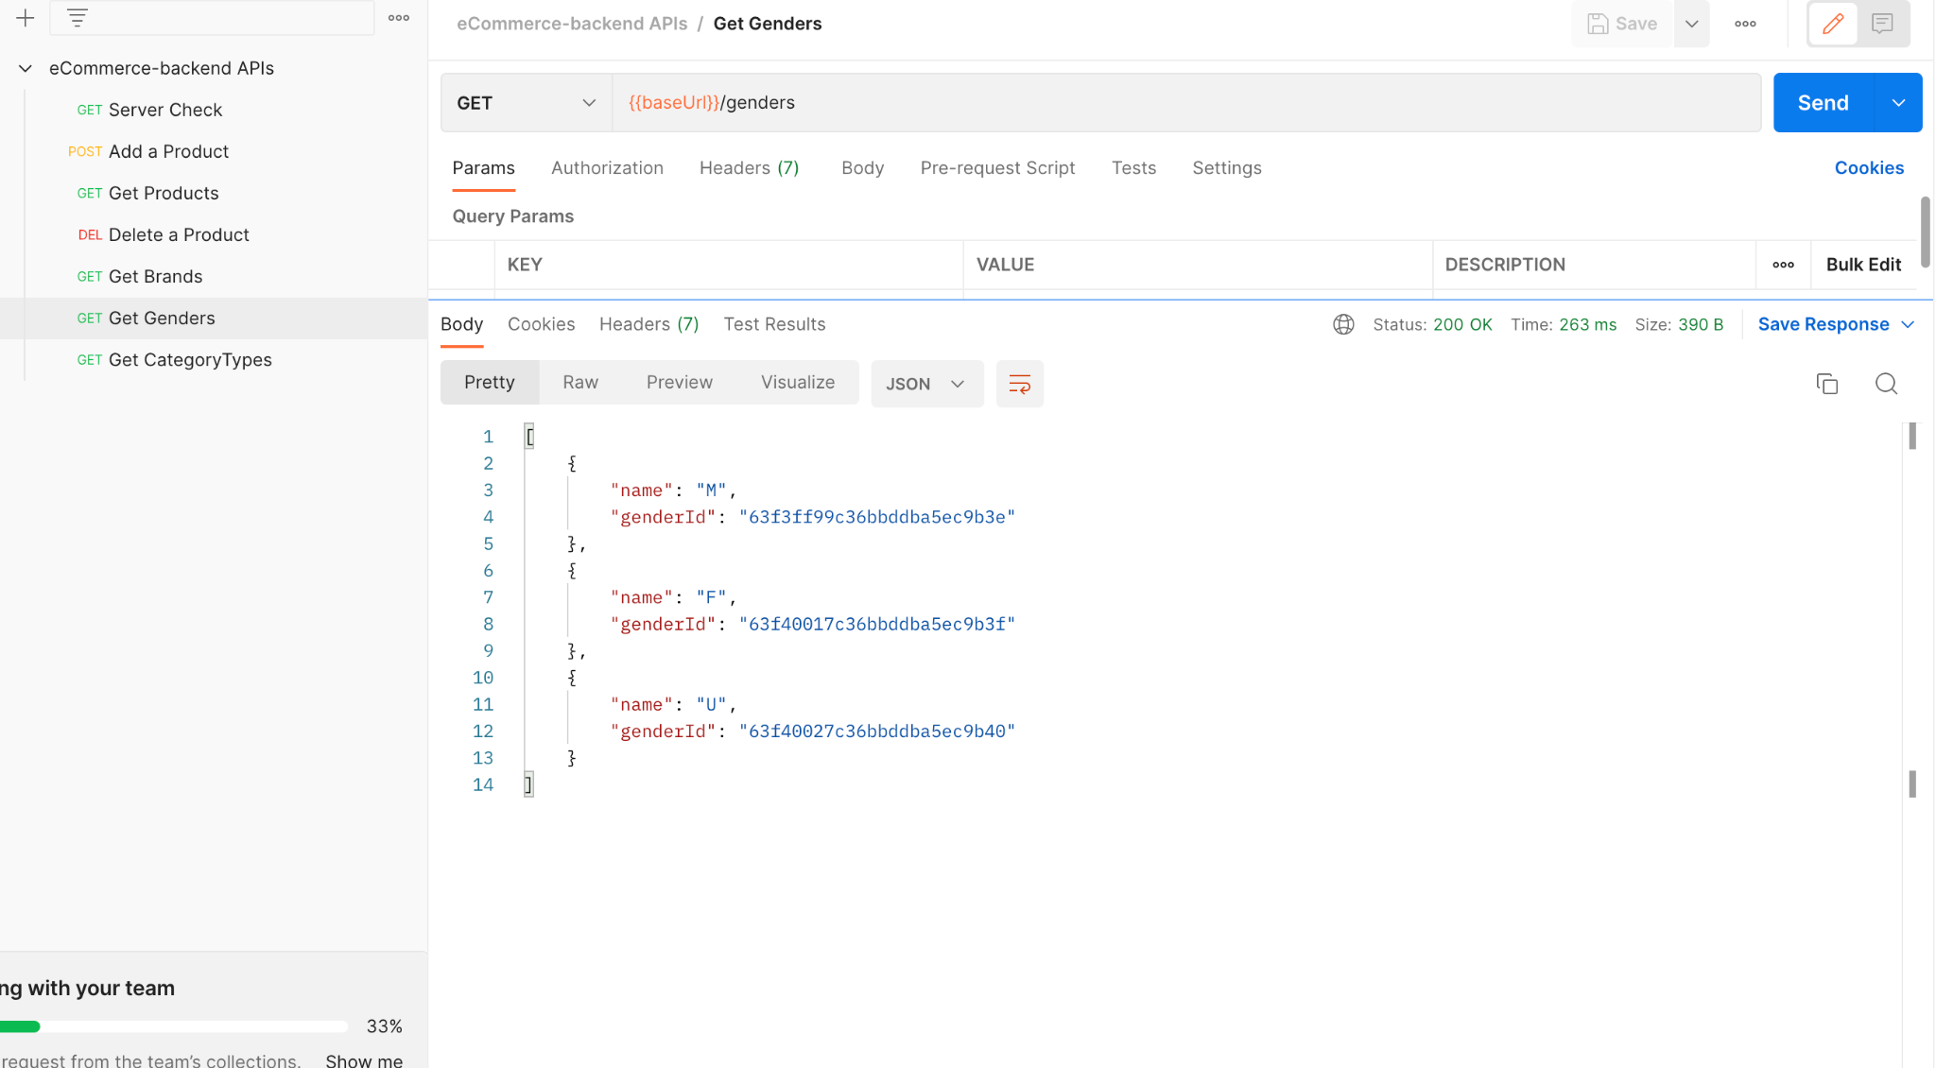

Slide 10
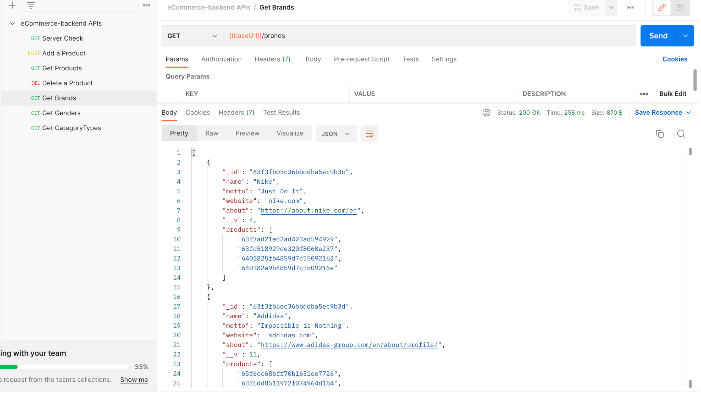

Slide 11
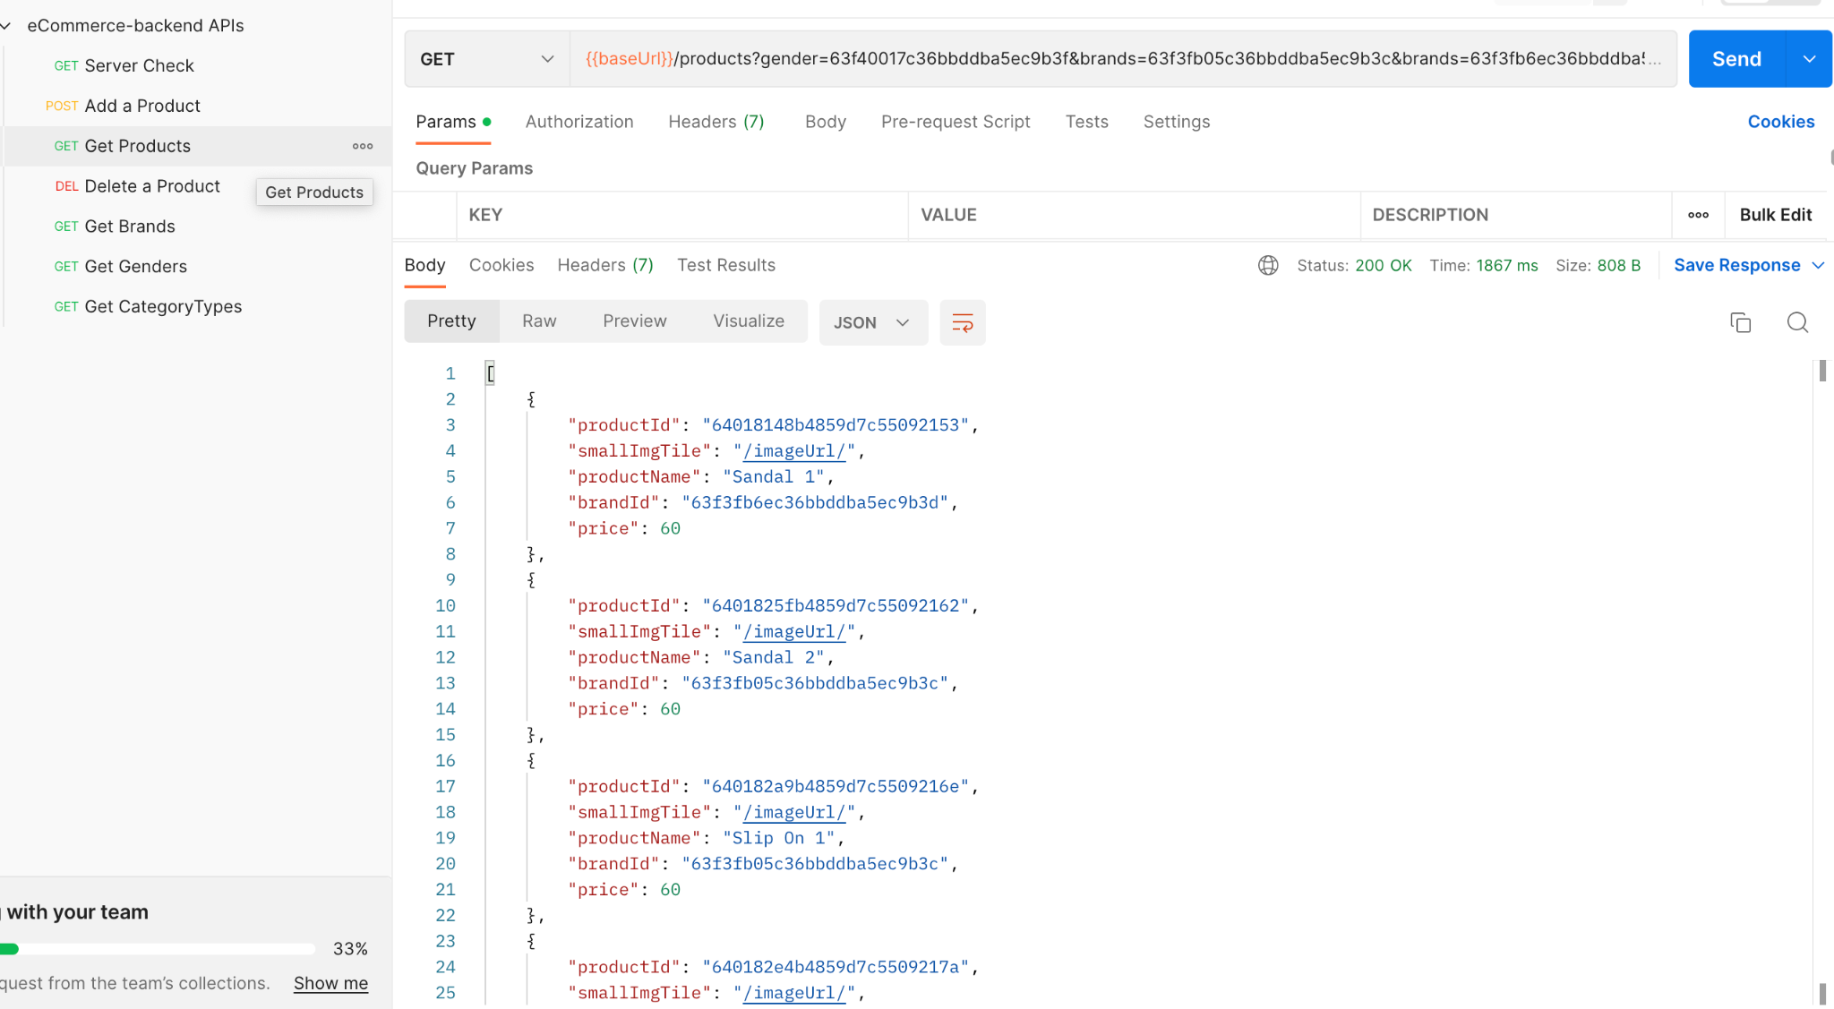

Slide 12
Test Plan
Cart: Should display # products in cart and info
Men/Women’s: Should filter items based on gender
Best Sellers: Should be displayed on home page with trending products
Checkout/Payment: Users should be able to complete their purchase
Order Summary: Should display order number and details

Slide 13
Test Plan
Seller page: should allow the seller to add items to the inventory, should display a form
User Authentication: Should allow users to login or create an account. Authenticates the users

Slide 14
Milestones
M1
Seller Page
M2
Shopping Cart
M3
Men/Women
Best Sellers
M4
User Auth
Order Summary
M5
Checkout/Payment

Slide 15
Treehouse Feedback:
Web app is running and looks neat
Is the search function under development?
Is there a way to embed the video in the webpage itself rather than linking it to vimeo?
Is the loading icon at the top of the home page something to be fixed soon?

Slide 16
Treehouse Feedback Response:
Loading icon will be replaced with an image
Search feature is part of the future scope
The vimeo video isn’t loading because its from the template but will be fixed.

Slide 17
Thanks!

